Slide 2
System Center Configuration Manager v.next Overview
Wally Mead
Senior Program Manager
Microsoft
Session Code: MGT302

Slide 3



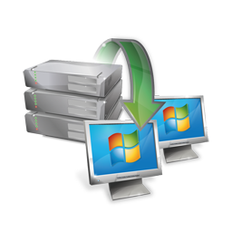



Pillars of the Release
Embrace User Centric
Provide a rich application management model to capture admin intent
Allow the administrator to think users first
Allow the user to define their relationship to applications
Improve the management of non-PC devices
Embrace User Centric
Provide a rich application management model to capture admin intent
Allow the administrator to think users first
Allow the user to define their relationship to applications
Improve the management of non-PC devices
Simplify and improve our cores
Redesigned core infrastructure and SQL Server replication
Improved scalability
Reduced latency
Automated content distribution
Client Health improvements and auto-remediation
Keep our customers happy
Redesigned admin experience and role-based security model
Native 64-bit and full Unicode support
Software Updates auto-deployment (including Forefront definitions)
Automated compliance remediation (DCM “set”)
And much, much more…

Slide 4
Embracing User-Centric End-User of the Future
Tomorrow's End-User is FAR More Tech Savvy Than Today’s
“Digital Natives” have never known life without a PC
Consumerization of IT
How and Where Users Work Will Change
2009 – 1 billion PCs, 3+ billion mobile devices
2010 – 12-17 million iCafe PCs serving 300+ million users in the 3rd world
Tomorrow’s IT Pro is in the Crosshairs
Demand for IT specialists will shrink 40% by 2010
Increased balance of versatilists

Slide 5

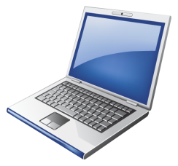




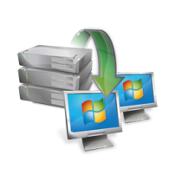

System vs. User-Centric
Systems Management of Today
Targeted at the device
Explicit and action-based
Software deployment is a glorified script execution engine
Optimized for systems management inside the firewall
Optimized for tight IT control, minimal end user involvement
User-Centric Client Mgmt of Tomorrow
Targeted at the end user
Implicit and intent-based
Software deployment is about delivering the right app in the right way to the right user under the right condition
Enable the user to be productive anywhere and anytime
Maintain IT control while balancing the needs for end user empowerment

Slide 6




Embracing User Centric Administrator Promises
Application management model to capture admin intent
Manage apps, not setup scripts
Conditionally deliver the app to the user in the right way based on rules
Let the admin think user first
Software targeted at the user and delivered to systems based on their relationship to the user

Slide 7
Embracing User Centric Let the User define her relationship to applications and to ConfigMgr
Self-service application web portal
Easily find and request software for your job
Choose software intelligently thanks to clear, consistent and concise information about applications and their impact
Application subscriptions persist your relationship with the software
User preferences control ConfigMgr behaviors (e.g. “my business hours”)
Manage impact from software installation and system restarts

Slide 8
Device Management
MDM 2008 SP1
Comprehensive Windows Mobile 6.1 device management, enabling IT control for security, management and access.
ConfigMgr v.Next
Comprehensive management of Windows Mobile and CE devices based on device capability for Enrollment OTA, SWD, SW Inventory, HW Inventory, DM Settings
Unified administration experience and infrastructure for all devices
ConfigMgr 2007
Delivers proven, robust capabilities for managing your IT systems including your desktop, laptop, server, and mobile devices.

Slide 9
ConfigMgr v.Next Device Mgmt
Investment Pillars | Detail
Centralize and focus device management investments | Migration of System Center Mobile Device Manager scenarios to ConfigMgr Migration of ConfigMgr 2007 device mgmt capabilities Introduction of cross platform mobile device support
Enable User-Centric device management | Ability to delivery software to the device based on user Enable user to self-provision apps to their mobile device Application allow/deny based on user role and configuration policies Ability to set device configuration policies based on user role
Enable the mobile Line Of Business App | Ability to distribute software to mobile devices through same admin UI as desktop/laptop Ability to target software delivery based on user or device
Enable compliant, secure management of mobile devices | Secure, over-the-air enrollment Ability to set device configuration policy Ability to monitor against configuration policies and automatically remediate out-of-compliance devices Provide discovery and inventory of hardware and software for mobile devices

Slide 10
Simplify and improve our cores
Embrace User Centric
Provide a rich application management model to capture admin intent
Allow the administrator to think users first
Allow the user to define their relationship to applications
Improve the management of non-PC devices
Simplify and improve our cores
Redesigned core infrastructure and SQL Server replication
Improved scalability
Reduced latency
Automated content distribution
Client Health improvements and auto-remediation
Keep our customers happy
Redesigned admin experience and role-based security model
Native 64-bit and full Unicode support
Software Updates auto-deployment (including Forefront definitions)
Automated compliance remediation (DCM “set”)
And much, much more…

Slide 11

Administrator Experience: Console
MMC replaced with System Center UI Framework
Common look and feel across System Center products
Improved feature discoverability and time spent on task with new “information architecture”
In-console alerts
At-a-glance scenario status relevant to the administrator (e.g. Configuration settings policy exceeds non-compliance threshold)
Context-sensitive actions available from the alert (e.g. Go to Source, Close alert, Open log file, Help, etc…)

Slide 12
Role-Based Administration
Security Role
Group sets of permissions together that collectively define a scope of work
e.g. Read Program + Deploy Program + Read Collection + Advertise to Collection = Software Distribution Administrator
Security Scope
Category metadata that controls visibility and access to instances of objects
E.g. “North America”; “Sales & Marketing”
Admin users will see only those objects that share a common Security Scope

Slide 13
Role-Based Administration Example
Collections
Configuration Items
All Systems
Finance
Read/Advertise
Sales
N. America
Standard Desktop
HR Systems
S. America
Assign Security Scope:
Sales & Marketing
Assign Security Scope:
South America
Assign role: Software Distribution Administrator
Advertisements
HR
EMEA
Datacenter Servers
OS Images
Read/Create/ Modify
DEP5678
DEP1234
DEP5678
DEP8787
DEP9246
DEP1234
Windows Vista
Windows 7
DEP5678
DEP1234
DEP5678
DEP5678
Windows Server 2008
Software Updates
Packages
Update for Office 2007
Read/Create/ Modify
Update for Office 2007
Update for Office 2007
Office – MUI (Japanese)
Billing Tool
Update for Office 2007
Update for Office 2007
Update for Office 2007
Update for Office 2007
Update for Office 2007
Update for Office 2007
Office – MUI (Spanish)
Update for Office 2007
Update for Windows
Time Card
Update for Office 2007
SAP - HR
SAP - Sales

Slide 14
Infrastructure Changes Modernizing our architecture
Primaries are needed for scale out only
Client agent settings configurable by collection
Segmentation via Role Based Access Control
Scalability and Data Latency Improvements
Central Administration Site (CAS) is just for administration and reporting
Other work distributed to the primaries as much as possible
System-generated data (HW Inventory and Status) can be configured to flow to CAS directly
File processing occurs once at the Primary Site and uses replication to reach other sites (no more reprocessing at each site in the hierarchy)
New replication methods for site-to-site communications
Industry standard SQL replication sub-system simplifies troubleshooting and reduces operational costs
Improved reliability over SMS/ConfigMgr’s custom file replication

Slide 15
Infrastructure Changes Handling content
Sender Capable DPs
Apply throttling and other sender controls directly to DPs (reduce need for secondary sites)
Fewer DPs and Branch DPs required thanks to support for Win7 P2P (BranchCache) beginning with ConfigMgr 2007 SP2
Vista, Server 2008 P2P coming post Win7
“State-based” DP Groups
Manage content distribution to individual DPs or groups of DPs
Content automatically added or removed from DPs based on group membership
DP group associations with collections automate content staging for software targeted to the collection

Slide 16
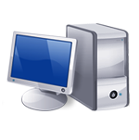
ConfigMgr 2007 Site Server Model
ConfigMgr.next Site Server Model
Chicago Central Site
CAS Site
Germany Primary Site
Primary Site
Seattle Office
Primary Site
Primary Site
Primary Site
Secondary Site
Sender Capable DP
Houston Office
Miami Office
Paris Office
East Office
Madrid Office
Primary Site
Tokyo Office
Branch DP
Branch DP
Satellite Office x 3
Secondary Site
Satellite Office x 3
DS3
T1
Branch DP
DSL
Satellite Office x 4

Slide 17
Client Health
Server-side metrics covering policy requests, HW & SW Inventory, Heartbeat DDRs and Status Messages
Out-of-the-box support for:
Client prerequisite monitoring & remediation
Automatic ConfigMgr client reinstallation
Windows Services monitoring & remediation
WMI Repository, Namespace, Class, and Instance health evaluation monitoring & remediation
Customize for your environment
In-console alerts when healthy/unhealthy ratio drops below configurable threshold

Slide 18
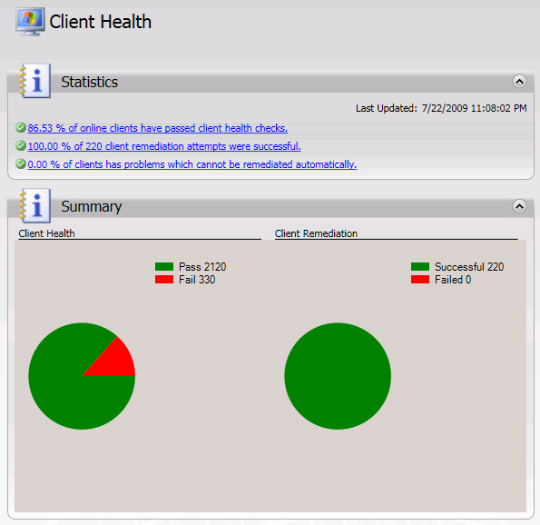
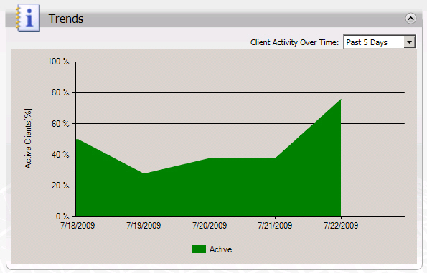
Client Health Admin Dashboard

Slide 19
Infrastructure Changes Integrated SQL Reporting
100% SQL Server Reporting Services
SQL Reporting Services 2008 Sp1 required
ConfigMgr-to-SSRS report conversion tool available to ConfigMgr 2007 R2 customers
View subscriptions for reports
Launch SSRS Report Builder 2.0 for report authoring

Slide 20
Keep our Customers Happy
Embrace User Centric
Provide a rich application management model to capture admin intent
Allow the administrator to think users first
Allow the user to define their relationship to applications
Simplify and improve our cores
Redesigned core infrastructure and SQL Server replication
Improved scalability
Reduced latency
Automated content distribution
Client Health improvements and auto-remediation
Keep our customers happy
Redesigned admin experience and role-based security model
Native 64-bit and full Unicode support
Software Updates auto-deployment (including Forefront definitions)
Automated compliance remediation (DCM “set”)
And much, much more…

Slide 21

More Improvements
Software Update: Auto Deployment Rules
Use search criteria to identify class of updates to automatically deploy: category, products, language, date revised, article id, bulletin id, etc.
Schedule content download and deployment based on sync schedule or define a separate schedule per rule
Send Ctrl-Alt-Del keystroke to host device
Switch users during an active session
Control a locked desktop
Access the Secure Desktop
Access Winlogon screen

Slide 22
More Improvements Cont.
Offline Servicing of Images
Administrator schedules CBS based updates from the deployed updates
OEM Media
Create hybrid boot media/OS WIM file for use with your OEM
Design to interact with your task sequence
Boot Media Updates
Unattended boot media mode suppresses user interaction for native screens in the boot media wizard
Use scripting or custom HTA in pre-execution hook to automate the selection of an optional advertisement for task sequences
USMT 4.0
UI integration and support for hard-link, offline and shadow copy features

Slide 23
Desired Configuration Management
Optional automatic remediation for non-compliant registry-, wmi- and script-based settings (aka DCM “set”)
More flexibility for re-use of settings across CI boundaries
Define compliance SLAs for Baselines to trigger console alerts
Improved CI versioning and audit tracking
DCM vs. GP
DCM provides better reporting of configuration problems
Understand source of compliance problems
Remediation reports identify settings re-configured, frequency of settings drift, and conflict and error reporting
DCM provides greater flexibility for settings management:
Settings re-use (parent/child CIs; settings browse)
Composability of settings policies (baselines; nested baselines) offer greater re-use and more flexible administrative control

Slide 24
Prep Now for ConfigMgr vNext
Minimum System Requirements:
Site servers and site roles require 64-bit OS (distribution points are an exception)
Branch DPs can run on any v.Next-supported client OS
Standard DPs can run on Windows Server 32-bit but will not support advanced functionality (e.g. single instancing for application models)
Windows Server 2008
Distribution points can run on Windows Server 2003
SQL Server 2008 (64-bit)
Flatten your ConfigMgr 2007 hierarchy
Move to SQL Reporting Services
Start learning about SQL replication
Start implementing BranchCache™ with ConfigMgr 2007 SP2

Slide 25
question & answer

Slide 26

© 2009 Microsoft Corporation. All rights reserved. Microsoft, Windows, Windows Vista and other product names are or may be registered trademarks and/or trademarks in the U.S. and/or other countries.
The information herein is for informational purposes only and represents the current view of Microsoft Corporation as of the date of this presentation. Because Microsoft must respond to changing market conditions, it should not be interpreted to be a commitment on the part of Microsoft, and Microsoft cannot guarantee the accuracy of any information provided after the date of this presentation. MICROSOFT MAKES NO WARRANTIES, EXPRESS, IMPLIED OR STATUTORY, AS TO THE INFORMATION IN THIS PRESENTATION.

